Slide 1


Community SRM
Empowering Innovation, One Awesome Hack at a Time!

Slide 2

Community SRM
GreenScore
Team Name: Byte Busters Team Lead: Rohit Kumar Track: CSE CORE

Slide 3


Community SRM
PROBLEM STATEMENT
GreenScore allows users to reduce their carbon footprints by monitoring the environmental impact of each transaction and challenging its users with gamified rewards for sustainable spending. Making it possible for a user to make informed decisions moves us towards lowering emissions and building a greener future.
Track transaction
calculate Carbon FootPrint
Assign Greenscore
Reward Improvement

Slide 4
Community SRM
PROPOSED SOLUTIONS
The problem we are trying to solve is that the people and companies do not have the ease of access to the resources to understand how their financial decisions affect the environment we will provide them a platform to keep a track of their personal carbon footprint.

Slide 5
Community SRM
PROPOSED SOLUTIONS
We are tracking the everyday transactions of the individual to generate a more relevant calculation of the Carbon Footprint emitted by the individual.
We are incentivising the individuals with the help of greenScores earned per transaction.

Slide 6
Community SRM
TECHNICAL APPROACH
GreenScore pulls in transaction information using banking APIs Plaid and Yodlee. Then, the AI/ML Models use CarbonKit APIs to categorize the transactions into various types and estimate the carbon footprints. A React.js application displays users’ GreenScores, insights, and rewards in real-time. Redis caches the most frequent queries while PostgreSQL stores the user information. Payments for offsets are handled by Stripe. Node.js or Python are used for the backend logic to perform calculations and integrations. Carbon offset tracking is gamed as well. On top of that, the cloud infrastructure is hosted on Amazon Web Services or Google Cloud Platform for scalability and security. The system is constantly updated effortlessly by using CI/CD pipelines.

Slide 7
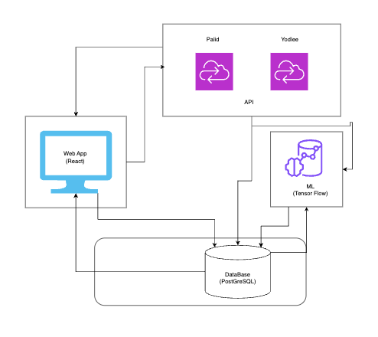
Community SRM
TECHNICAL APPROACH

Slide 8
Community SRM
FEASIBILITY & SCALABILITY
GreenScore is cost-effective by utilizing APIs like Plaid, CarbonKit, or open-source software like React or Tensorflow. Their cloud infrastructure on AWS or GCP guarantees the platform's modular design can support millions of users. Collaborations with banks and retailers may increase usage, while AI engagement and gamification sustain user retention. The platform’s adaptability facilitates expansion into additional markets and sectors for overreaching sustainable growth.

Slide 9
Community SRM
TEAM MEMBERS
Team Lead: Rohit Kumar Email: rk5108@srmist.edu.in Phone: 6202003348 Member 2: Kumar Tejash Email: kmrtejash@gmail.com Phone: 7294928700 Member 3 : Rahul Negi Email: rahulnegi0456@gmail.com Phone: 730082002 Member 4 : Ayush Baoker Email: ayush.baoker@gmail.com Phone: 9685932207

